Slide 1
Running MySQL on Kubernetes Patrick Galbraith, Oracle

Slide 2

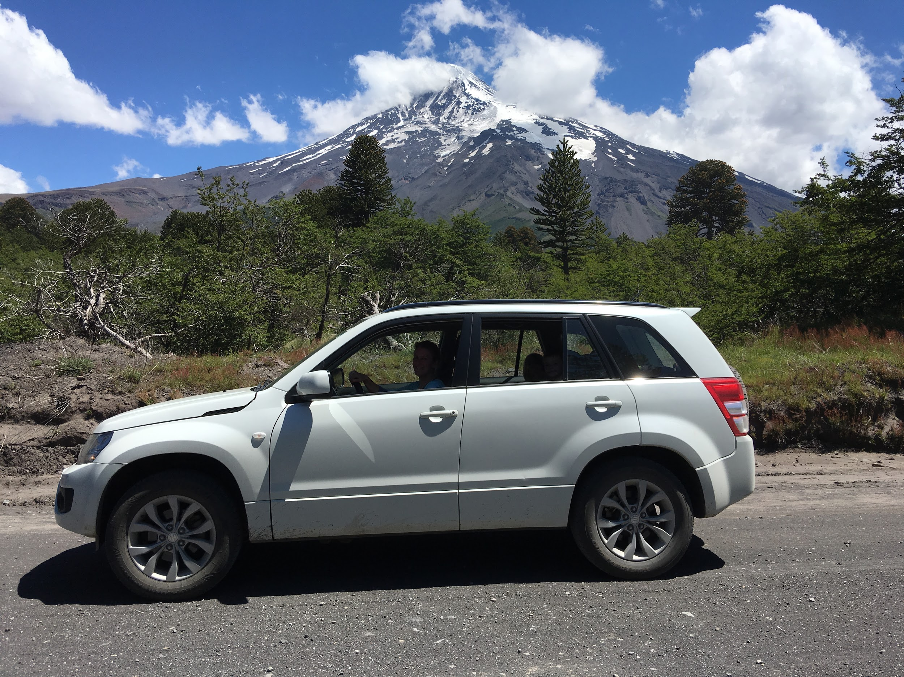
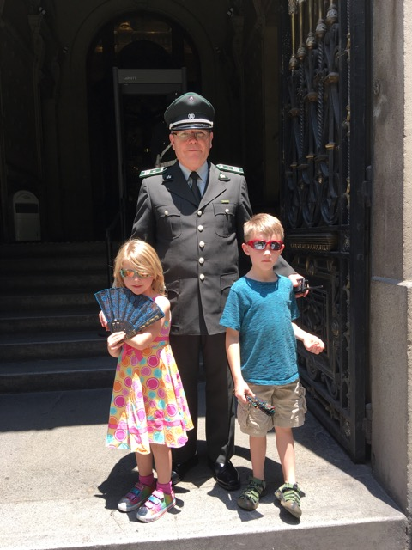
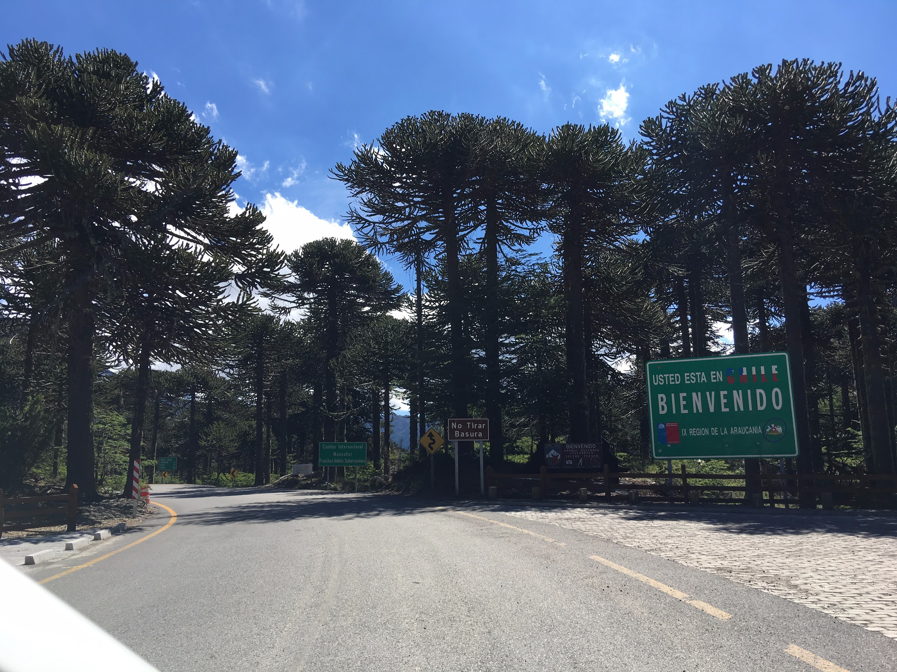
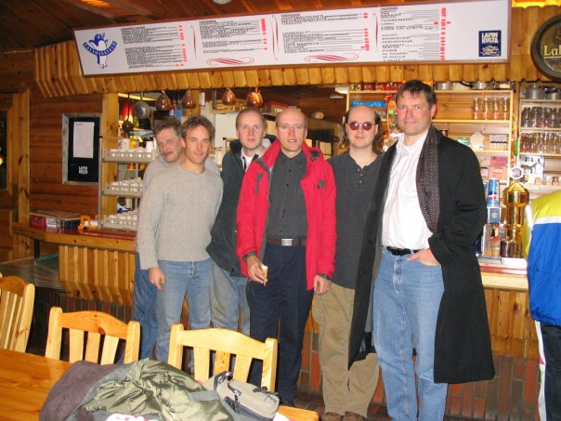



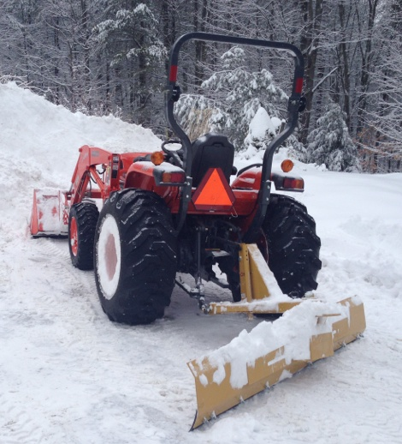
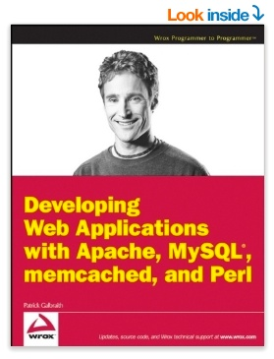
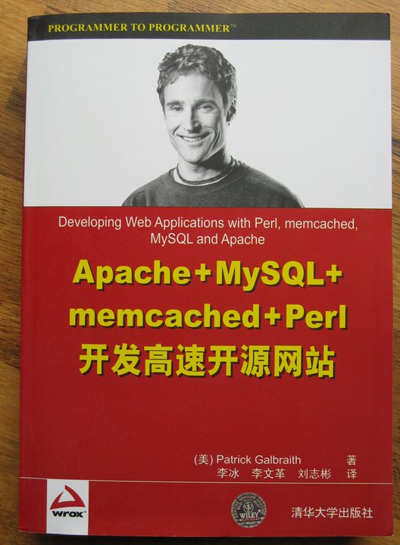
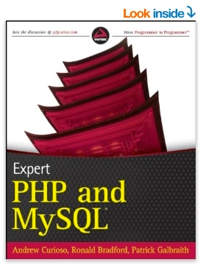

Patrick Galbraith
Oracle MySQL Cloud Service
Oracle, Dyn, HP, Blue Gecko, MySQL AB, Classmates, Slashdot, Cobalt Group, US Navy
MySQL projects: memcached UDFs, DBD::mysql, federated storage engine, Galera on Kubernetes example, Percona helm chart, etc
Learning, Languages, Family, Outdoors
Chile
Not a designer, as you can see :)
Notes:
0-1 min 15:51

Slide 3
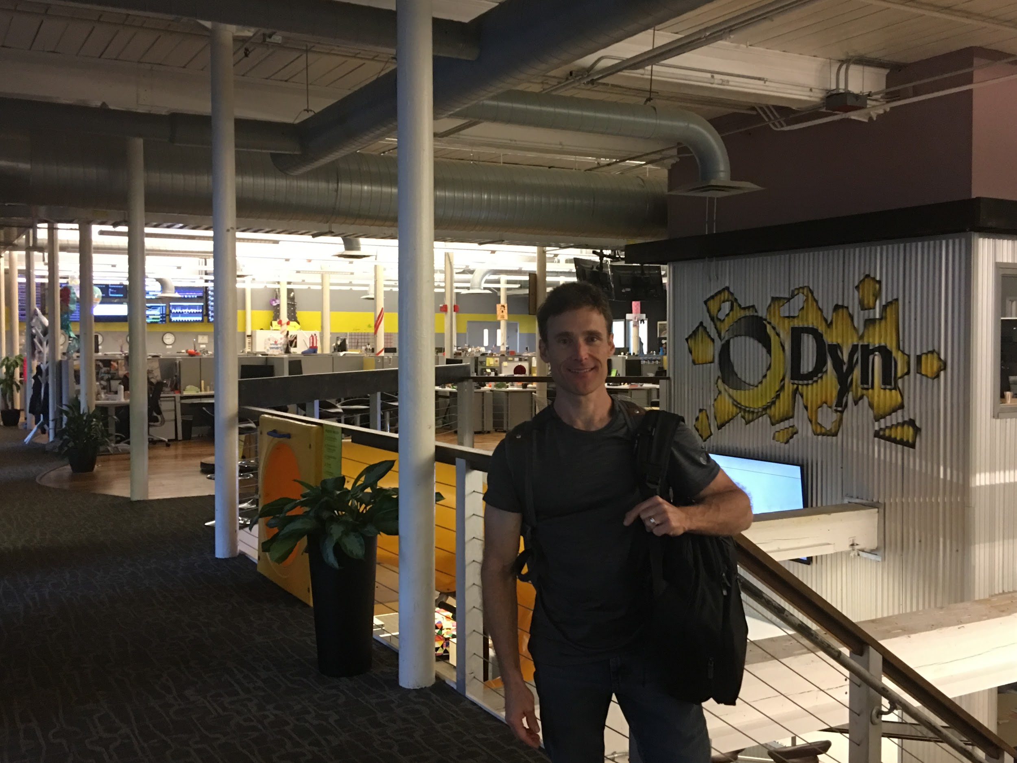

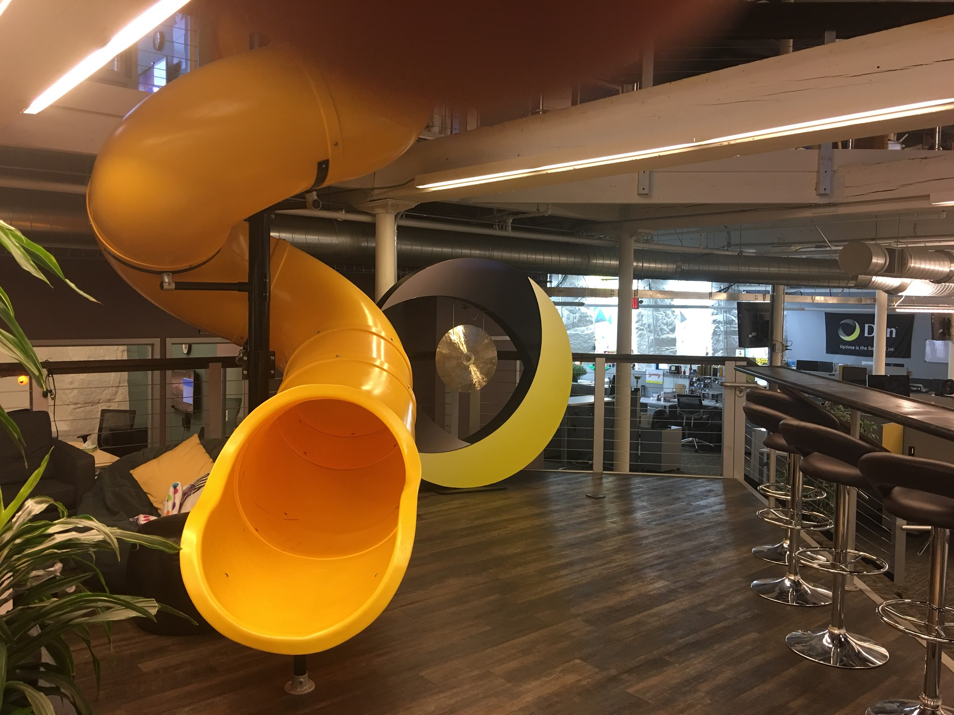
About my team
Oracle MySQL Cloud Service (MySQLaaS)
Leverages MySQL and Oracle Cloud
Self-managed, ease of use
APIs, CLIs, SDKs
Seemless integration
Elastic
HA – replication across physical locations
Security and Compliance
Backups/restore
…
Oracle Cloud (OCI) https://cloud.oracle.com/home
Notes:
1-2 min 15:52
Nov 21, Feb 2 data centers: Frankfurt Ashford VA Phoenix AZ planned data centers: one each quarter London next - this quarter Singapore next - next quarter fully-formed - triple redundant domains per data center when you buy compute, you set 3S - backbone 25G between each copy - no up-charge, elasticity oracle has its own fiber backbone, over Oracle network, not over Internet each 100Ks of servers building ahead of demand space and density - 3 and 5x sparc technology - denser and more performance, bigger nodes bare metal environment - run anything in any combination effort for 3rd party much smaller with bare metal RDS, compute, block store, high performance storage system, high performance compute system OCI backup site Fast Connect - backup location to primary location, end-to-end, Longer end-to-end solution, beyond "the cloud" dedicated hardware, storage, network, fiber... ddos mitigation, dns, email,

Slide 4
What is this presentation about?
De-mystifying containers
MySQL running on containers
MySQL on Kubernetes
Stateful applications – StatefulSets
Operators - MySQL Operator
Sharding - Vitess
Time permitting…
Save questions until the end ☺
Notes:
2-2.5 min 15:52:30

Slide 5
Some things to consider with Containers
Docker is a set of tools for managing containers
Command line tool client and daemon
Kernel namespaces – the core ingredient to containers working
PID
IPC
uts (what will be seen by a group of processes)
Mount
Network
User
Cgroups (control groups) -- limit, account and isolate resource usage
Cgroups (CPU, memory, disk I/O, etc.) of process groups
Notes:
2-2.5 min 15:52:30

Slide 6
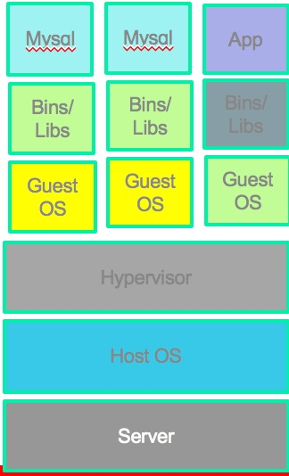
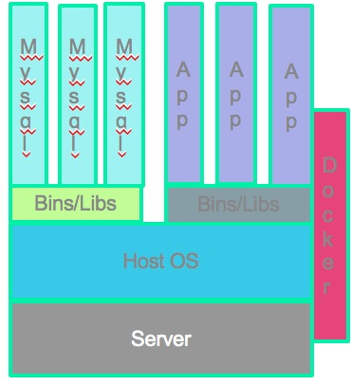
VMs and Containers
comparison
VM
Container
Notes:
2-2.5 min 15:52:30

Slide 7
VMs vs. Containers
VMs require OS installation on a software emulated machine vs. containers which include only the application and use the host OS/Kernel
VMs provide an abstract machine, Containers provide an abstract OS
VMs have a hypervisor/emulation layer whereas containers are more isolation than virtualization
VMs have a longer life span vs. containers
VMs have their own filesystem and interact with external storage like a real machine whereas containers have an ephemeral disk that exists on the host OS and can specify volumes for persistent data that can be on the host or external storage on the host
VMs networking is specific to the virtual machine whereas containers
VMs are more secure, more isolated than containers.
Host cannot set VM processes, but host can see container processes
Notes:
2-2.5 min 15:52:30

Slide 8

Oh no! Databases on containers?!
More of a misconception than reality
Containers make it simpler to run any application
Testing is made easier
No emulation layer
Notes:
2-2.5 min 15:52:30

Slide 9
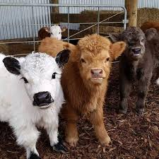

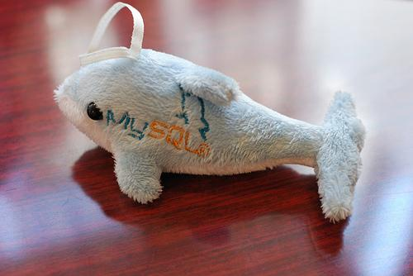
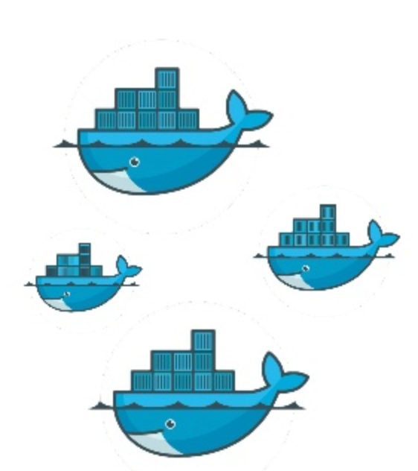
Databases: Pets vs. Cattle
Databases tend to be more pets than cattle
A pod of multiple database instances or one?
“Kubernetes Pods are mortal.”
A database is a complex, stateful, application
Stable access: applications get the same database handle
Safety: don’t scale if unhealthy (obvious)
Persistent storage
Notes:
3.5-4.5 min 15:54:30
Discovery - being able to find stuff
Repeatability - can this be created at scale in a way expected?
Unified interaction/management: how many bookmarks?!
Scale out, in, up, down - we need resources! Or, company credit card is not happy
Ability to debug - there’s a problem, how do I dig into these container things to see what’s broken?
Monitoring - can we get paged when things break?
Logging - we need to look around in the logs… log audits (ugh)

Slide 10
Database containers are…
The containers are cattle!
The data is the pet!
The steer
AKA “The container”
secrets
Mysql binaries
The ”Pet” AKA “Your Data” Block storage
Libraries, etc
/etc/mysql/conf.d/*
/var/lib/mysql
configmap
Notes:
2-2.5 min 15:52:30

Slide 11

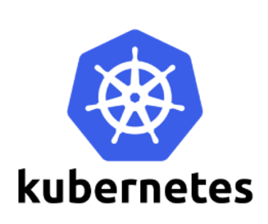
A tale of two open source projects
MySQL and Kubernetes
MySQL
World’s most popular open source database
Ubiquitous
20+ years
Kubernetes
Fastest growing open source project
Application deployment done right
Community-driven
Moving target, rapidly developing
Borg Paper https://research.google.com/pubs/pub43438.html?hl=es
Notes:
2.5-3.5 minutes 15:53:30

Slide 12

Kubernetes ingredients for stateful applications
Labels
Services
KubeDNS
Helm Charts
PV/PVC, StorageClass
StatefulSets
Init containers
VolumeClaimTemplates
Operators
CustomResourceDefinition
Side-car containers
nodeSelector
Notes:
4.5-5 min 15:55
PersistentVolume: Disk resources available
PersistentVolumeClaim: Used by pod
VolumeClaimTemplates: mapping network identities to claims
StorageClasses: describes classes of storage - quality of service levels
Types: gcPersistentDisk, awsElasticBlockStore, NFS, Ceph, Glusterfs, ...
With StatefulSets, dynamic allocation using volumeClaimTemplates with storageClassName

Slide 13
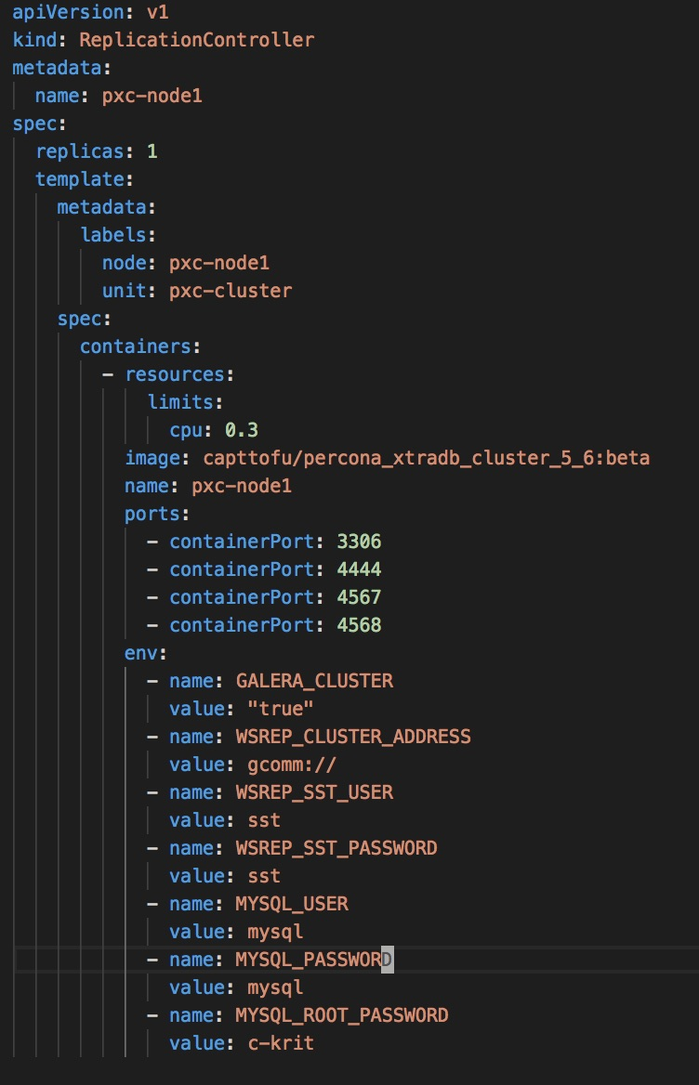
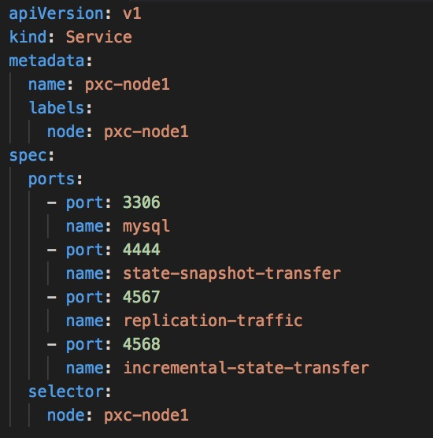
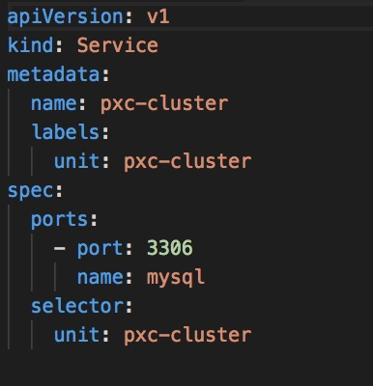
Starting out simple but manual

Slide 14


Helm
helm install --name my-release stable/mysql
helm install --name my-release stable/percona
helm install stable/mariadb

Slide 15
NodeSelector
Can be used to achieve affinity to a specific node
Label assigned to node
kubectl label nodes ip-172.xxx.ec2.internal boxtype=c3.medium
spec:
containers:
- image: mysql:5.6
name: mysql
...<snip>...
nodeSelector:
boxtype: c3.medium

Slide 16
Node and Pod Affinity/AntiAffinity
Based on labels
nodeAffinity/nodeAntiAffinity uses labels on node
podAffinity/podAntiAffinity labels of pods already running on node
metadata: name: with-node-affinity (or with-pod-affinity)
spec: affinity: nodeAffinity:
Hard - “must” requiredDuringSchedulingIgnoredDuringExecution
Soft - “preferred” preferredDuringSchedulingIgnoredDuringExecution
Notes:
Stickyness of storage, Pin to machines/nodes Borg uses this in production - Why on k8s: pack these things to a given machine - split databases into small pieces
Kubernetes helps to manage the explosion of items when you split your databases
Allows you to manage 1000s of things as one entity Vitess - bare metal vs. k8s : large number of scripts on BM, hard-coding, etc, whereas k8s dynamic, easier to manage, abstracted, scripts easier to maintain Anti-affinity: don’t share slaves on same host

Slide 17
StatefulSets
Provide guarantees about ordering and uniqueness of pods and pod resources
Maintains persistent, sticky identity for each of their pods, across rescheduling
Ensures ordinality - Deterministic initialization order.
At most one pod per index
Pods are not interchangeable and won’t attempt to run a pod with the same name
Stable network identity
Consistent pod name set as subdomain within domain of headless service, eg mysql, node’s name would be name node-N.mysql
DNS name is stable across restarts
Stable Storage/Stateful resources.
Pods re-mount same persistent storage across restarts
Safety
Scaling is blocked if system is unhealthy
Notes:
5-6.5 min 15:56:30
StatefulSet is the workload API object used to manage stateful applications.

Slide 18
Deployment/ReplicaSet
Started in no specific order
name-<depid>-<rand alpha>
Will scale if crash and replace with another non-unique name
Deployment/ReplicaSet
“mysql”
mysql-1389738847-bmsg7
mysql-1389738847-nz828
mysql-1389738847-x99km
mysql-1389738847-t542x
Crash!
Notes:
6.5-7 min 15:57

Slide 19
StatefulSet
Started in order
Names unique and distinct per node-ordinal
Must replace failed node by name
Won’t scale when cluster is unhealthy
StatefulSet
”mysql”
Don’t scale and must replace mysql-2
mysql-0
mysql-1
mysql-2
Crash!
C
Notes:
7- 7.5 min 15:57:30
Diff rep vs. stateful set Statefulset tracks the identify - identify is maintained, doesn’t die with pod, replace it, use the same identity of all objects pod uses (name of service, labels), instance UUID internally (?)

Slide 20
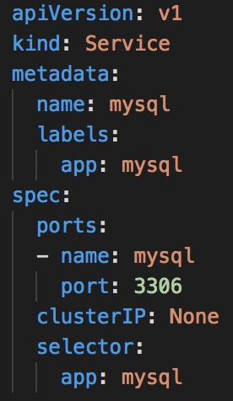
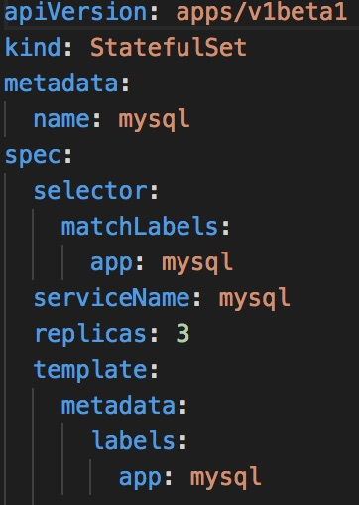
Headless Service
Service with clusterIP of None
Creates a domain mysql
Each node is assigned an A-record of mysql-<ord>.<service name>
This service is not used for application or clients
For read-only, create another service - mysql-read which can be of any type (nodePort, clusterIP, loadBalancer) specifying nodes of choice in labels

Slide 21
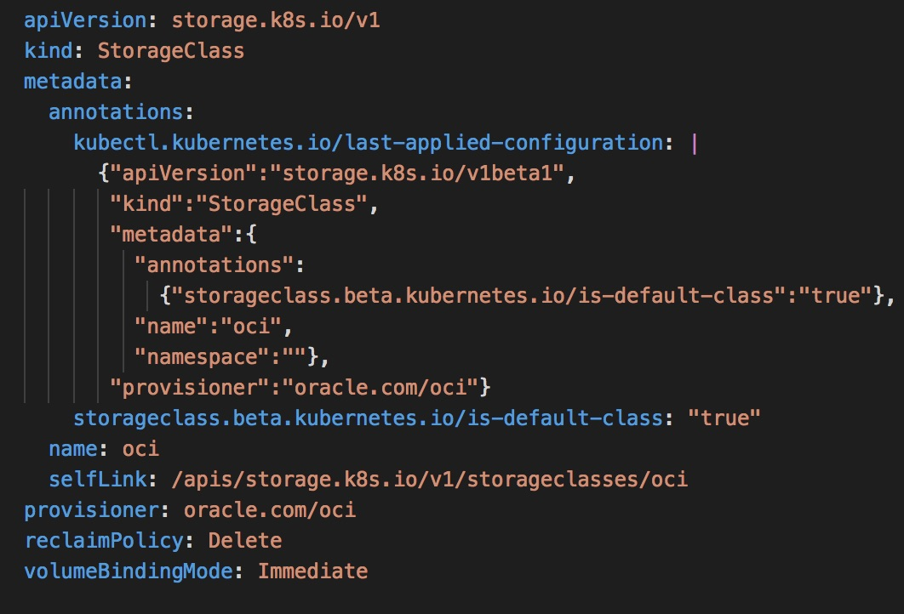
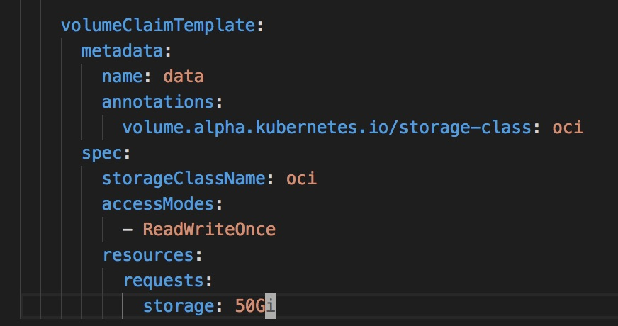
StorageClass and VolumeClaimTemplate
Notes:
a

Slide 22
MySQL simple replication StatefulSet
https://kubernetes.io/docs/tasks/run-application/run-replicated-stateful-application/
App /
client
mysql-1
Mysql-read service
Read only
-h mysql-read
replication
mysql-0
read/write
-h mysql-0.mysql
replication
mysql-2
Notes:
Utilizes a StatefulSet which creates pods one at a time in order of ordinal index (<statefulset-name>-<ordinal-index>)
Allows for scaling slaves
Async replication
ConfigMap for master and slave data used by initContainers to set up master and slaves
Two services - one for stable DNS entries used by statefulSets, another for reads
Mysql container and an xtrabackup container using patterns from Galera SST
Use of VolumeClaimTemplate for pre-defined storage class
Statefulset of 3 replicas
For each replica (3):
Init containers
init-mysql:
Create /mnt/conf.d/server-id.cnf
Echo server-id 100 + ordinal into server-id-.cnf
If ordinal == 0
Cp /mnt/config-map/master.cnf /mnt/conf.d
Else
Cp /mnt/config-map/slave.cnf /mnt/conf.d
Clone-mysql container:
Skip if /var/lib/mysql/mysql exists (data already there)
Skip if ordinal 0 (master)
Use ncat receive port 3307 from previous peer ordinal-1 | xbstream to /var/lib/mysql Xtrabackup prepare data in /var/lib/mysql
Volume mount /var/lib/mysql (data) and /etc/mysql/conf.d (/mnt/conf.d) from
Containers: Mysql:
Mysql-0 master, init-mysql set up from configmap, clone-mysql makes backup
livenessProbe: mysqladmin ping
Readiness probe: select 1
VolumnMounts:
Data: /var/lib/mysql
Conf: /etc/mysql/conf.d
Xtrabackup:
If xtrabackup_slave_info, copy to change_master_to.sql.in
Else if xtrabackup_binog_info
Grep log file and log pos to variable, cat into change_master_to.sql
Run ncat server 3307, xtrabackup
Volume mounts: conf an config-map Two services: mysql for stable DNS entries (clusterIP: None)
mysql-read for reads
mysql.mysql-0 for writes

Slide 23
mysql-N pod
An operator would have this functionality built-in
Config-map
Contains
master.cnf
slave.cnf
/mnt/config-map
Init containers
init-mysql
data
Copy master.cnf or slave.cnf depending on ordinal
clone-mysql
/var/lib/mysql
/mnt/conf.d
App containers
conf
Mysql
/var/lib/mysql
/etc/mysql/conf.d
backup
Init Containers
App Containers
Sidecar Containers
mysql-(N+1) pod
clone-mysql only restores if ordinal > 0 (slave)
init-mysql
clone-mysql
Notes:
9-9.5 min 15:59:30
Utilizes a StatefulSet which creates pods one at a time in order of ordinal index (<statefulset-name>-<ordinal-index>)
Allows for scaling slaves
Async replication
ConfigMap for master and slave data used by initContainers to set up master and slaves
Two services - one for stable DNS entries used by statefulSets, another for reads
Mysql container and an xtrabackup container using patterns from Galera SST
Use of VolumeClaimTemplate for pre-defined storage class
Statefulset of 3 replicas
For each replica (3):
Init containers
init-mysql:
Create /mnt/conf.d/server-id.cnf
Echo server-id 100 + ordinal into server-id-.cnf
If ordinal == 0
Cp /mnt/config-map/master.cnf /mnt/conf.d
Else
Cp /mnt/config-map/slave.cnf /mnt/conf.d
Clone-mysql container:
Skip if /var/lib/mysql/mysql exists (data already there)
Skip if ordinal 0 (master)
Use ncat receive port 3307 from previous peer ordinal-1 | xbstream to /var/lib/mysql Xtrabackup prepare data in /var/lib/mysql
Volume mount /var/lib/mysql (data) and /etc/mysql/conf.d (/mnt/conf.d) from
Containers: Mysql:
Mysql-0 master, init-mysql set up from configmap, clone-mysql makes backup
livenessProbe: mysqladmin ping
Readiness probe: select 1
VolumnMounts:
Data: /var/lib/mysql
Conf: /etc/mysql/conf.d
Xtrabackup:
If xtrabackup_slave_info, copy to change_master_to.sql.in
Else if xtrabackup_binog_info
Grep log file and log pos to variable, cat into change_master_to.sql
Run ncat server 3307, xtrabackup
Volume mounts: conf an config-map Two services: mysql for stable DNS entries (clusterIP: None)
mysql-read for reads
mysql.mysql-0 for writes

Slide 24
Operators
Application-specific domain controller
Encodes application-specific domain knowledge through extending Kubernetes API using custom resource definitions (CRD)
Enables users to create, configure, and manage stateful applications
Built upon resources and controllers concepts
Leverage Kubernetes primitives like ReplicaSets, StatefulSets, and Services
Operator executes common application tasks
Installed as a deployment
Application run using custom resource definition types for operator eg. EtcdCluster, Prometheus, MySQL Cluster, Backup, Restore, Oracle WebLogic etc
Notes:
7.5-8.5 min 15:58:30
Created by CoreOS
“An Operator represents human operational knowledge in software to reliably manage an application.”
Software that encodes application domain knowledge and extends the Kubernetes API through creating a new resource using a CustomResourceDefinition
simulates human operator behaviors
Enables users to create, configure, and manage applications
Automate away the human equation
Application specific controller that:
Continually compares desired state to actual state and takes action (observe, analyze, act)
Replaces failed nodes
Update versions
Ability to add CRD (custom resource definitions) for any number of features
Operators for
Etcd
PostgreSQL
MongoDB
Prometheus
… and now MySQL!!
(CRD) API resource allows you to define custom resources. Defining a CRD object creates an new custom resource with a name and schema that you specify.
In the Kubernetes API, a resource is an endpoint that stores a collection of APOI objects of a certain kind.
A custom resource definition (CRD) is an object that extends the Kubernetes API or allows you to introduce your own API into a cluster or project A customer resource definition file defines your own object file kinds and lets the API server handle the entire lifecycle
Deploying a CRD into the kubernetes cluster causes the Kubernetes API server to begin serving the custom resource
The API server creates a new RESTful resource path

Slide 25
Operators
https://coreos.com/blog/introducing-the-etcd-operator.html
observe
“etcdX” cluster has 2 running pods
etcd-0, version 3.1.1
etcd-1, version 3.2.10
Create/Destroy: No need for specifications of each member. Just size of cluster.
Resize: Only specify size. Operator will deploy, destroy, or reconfigure as needed
Backup: built-in, only need to specify backup policy
Upgrade: operator will ensure members are correct version avoiding headaches
Etcd operator https://youtu.be/tPSys734iNk
Analyze
Differences from desired config
Should be version 3.2.10
Should have 3 members
Act
How get desired config
Recover 1 member
Upgrade etcd-0 to 3.2.10
Notes:
8.5-9 min 15:59
Created by CoreOS
“An Operator represents human operational knowledge in software to reliably manage an application.”
Automate away the human equation
Application specific controller that:
Continually compares desired state to actual state and takes action (observe, analyze, act)
Replaces failed nodes
Ability to add CRD (custom resource definitions) for any number of features
Operators for
Etcd
PostgreSQL
Prometheus
… and now MySQL!!

Slide 26
MySQL Operators
Oracle: https://github.com/oracle/mysql-operator
Presslabs https://github.com/presslabs/mysql-operator
https://github.com/grtl/mysql-operator
Comparisons https://banzaicloud.com/blog/mysql-on-kubernetes/
Notes:
11.5 min-17.5min 16:07:30

Slide 27

Oracle MySQL Operator
https://github.com/oracle/mysql-operator
Deploy a highly-available clustered MySQL instance into Kubernetes with a single command
Watches the API server for Custom Resource Definitions related to MySQL (Cluster) and acts on those resources
Backup/Restore made simple with Backup, BackupSchedule, and Restore custom resources
MySQL 8.0
Utilizes Group replication/InnoDB cluster
Automated backup/restore to/from object storage
Notes:
9.5-10 min 16:00
The MySQL Operator is opinionated about the way in which clusters are configured. We build upon InnoDB cluster and Group Replication to provide a complete high availability solution for MySQL running on Kubernetes.
The MySQL Operator is a Kubernetes controller that can be installed into an existing Kubernetes cluster.
Once installed, it will enable users to configure and manage MySQL instances using a simple declarative configuration.
The MySQL Operator lets you deploy a highly available clustered MySQL instance into Kubernetes with a single command.
Tasks such as backing up databases and restoring from an existing backup are made extremely easy.
In short, the MySQL Operator abstracts away the hard work of running MySQL inside Kubernetes.
If you want to deploy MySQL inside Kubernetes, we recommend using the MySQL Operator to do most of the heavy lifting for you.
Can run sidecar MySQL router alongside k8s application as a best practice

Slide 28
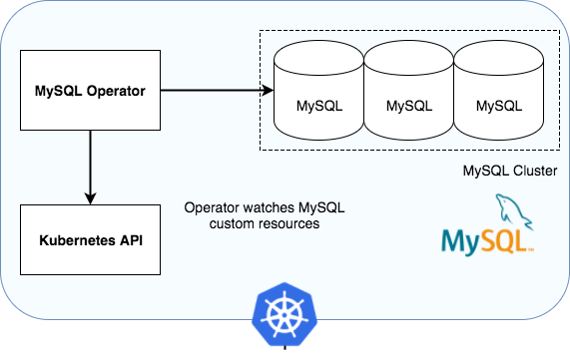
MySQL Operator
Features: Create/Scale/Destroy: Easily create, scale and delete self healing MySQL clusters inside a Kubernetes namespace
Simple Configuration: Provide configuration for your MySQL cluster with simple Kubernetes objects (Secrets and ConfigMaps)
Backups: Defined scheduled backup policies as part of your cluster to make sure your data is always protected or, alternatively, create on-demand snapshot backups with a single command.
Notes:
10-10.5 min 16:00:30 The MySQL Operator is opinionated about the way in which clusters are configured. We build upon InnoDB cluster and Group Replication to provide a complete high availability solution for MySQL running on Kubernetes.
While fully usable, this is currently alpha software and should be treated as such. You are responsible for your data and the operation of your database clusters. There may be backwards incompatible changes up until the first major release.
How it works
The MySQL Operator makes use of Custom Resource Definitions as a way to extend the Kubernetes API. For instance, we create custom resources for MySQLClusters and MySQLBackups. Users of the MySQL Operator interact via these third party resource objects. When a user creates a backup for example, a new MySQLBackup resource is created inside Kubernetes which contains references and information about that backup.
The MySQL Operator is, at it’s core, a simple Kubernetes controller that watches the API server for Customer Resource Definitions relating to MySQL and acts on those resources.

Slide 29


Oracle MySQL Operator
Mstatefulset (my-cluster)
Pod (my-cluster-N)
Object storage
Agent
Kubernetes API
Operator
CRD
MySQLCluster MySQLBackup
MySQLScheduledBackup MySQLRestore
Notes:
10-10.5 min 16:00:30 The MySQL Operator is opinionated about the way in which clusters are configured. We build upon InnoDB cluster and Group Replication to provide a complete high availability solution for MySQL running on Kubernetes.
While fully usable, this is currently alpha software and should be treated as such. You are responsible for your data and the operation of your database clusters. There may be backwards incompatible changes up until the first major release.
agent watches API – Backup, Restore controller, runs MySQLShell and sets up create cluster, join cluster, running reconciliation with state of cluster vs. statefulset (via k8s)
Operator reconciles stateful set
Picks secondary
Operator works on a cluster, agent works on node in uestions
Operator could go away, everything works as long as no need to scale up/down
Operator has go struct of the stateful set – definition CRD translates plumbs to stateful set, delegate responsibility to k8s itself
How it works
The MySQL Operator makes use of Custom Resource Definitions as a way to extend the Kubernetes API. For instance, we create custom resources for MySQLClusters and MySQLBackups. Users of the MySQL Operator interact via these third party resource objects. When a user creates a backup for example, a new MySQLBackup resource is created inside Kubernetes which contains references and information about that backup.
The MySQL Operator is, at it’s core, a simple Kubernetes controller that watches the API server for Customer Resource Definitions relating to MySQL and acts on those resources.

Slide 30
Examples: simple cluster
Create a cluster:
kubectl apply -f mysql-test-cluster.yaml
List clusters:
kubectl get mysql-operator.mysql.oracle.com
apiVersion: "mysql.oracle.com/v1"
kind: Cluster
metadata:
name: mysql
Notes:
10.5-11 min 16:01

Slide 31
Examples: simple cluster and backup
apiVersion: "mysql.oracle.com/v1"
kind: Backup
metadata:
name: mysql-backup
spec:
executor:
mysqldump:
databases:
- wordpress
storageProvider:
s3:
endpoint: dynbmcsandbox.compat.objectstorage.us-phoenix-1.oraclecloud.com
region: us-phoenix-1
bucket: mysql-backups
forcePathStyle: true
credentialsSecret:
name: s3-credentials
cluster:
name: mysql
Create a backup:
kubectl apply -f backup.yaml
List backups:
kubectl get mysqlbackups
Fetch an individual backup:
kubectl get mysqlbackup primary/123
Notes:
10.5-11 min 16:01

Slide 32
Examples: simple restore
apiVersion: "mysql.oracle.com/v1"
kind: Restore
metadata:
name: mysql-restore
spec:
clusterRef:
name: mysql
backupRef:
name: mysql-backup
Restore a cluster:
kubectl apply -f mysql-restore.yaml
Notes:
10.5-11 min 16:01

Slide 33
Examples: scheduled backup
apiVersion: mysql.oracle.com/v1
kind: BackupSchedule
metadata:
name: mysql-morning-backup
spec: schedule: '* 01 * * *'
backupTemplate:
executor:
provider: mysqldump
databases:
- wordpress
storageProvider:
s3:
endpoint: s3.us-east-1.amazonaws.com
region: us-east-1
bucket: mysql-demo-backup
credentialsSecret:
name: s3-credentials
cluster:
name: mysql
Notes:
10.5-11 min 16:01

Slide 34
Connecting
statefulset
Write-only service
mysql-0
Write directly to single pod
Read/Write-only service
MySQL Router
Read-only
service
mysql-1
mysql-router
mysql-2
Notes:
11.5 min-17.5min 16:07:30

Slide 35

Oracle MySQL Operator Demo
This demo will show the following:
A 3 Node cluster created by the Oracle MySQL Operator
Show each component such as the MySQL Operator container, and each pod node with the MySQL and each pod’s mysql-agent container
A Wordpress deployment consisting of the mysql-router container and wordpress that connects to the cluster
MySQLBackup and MySQLRestore resources demonstrating restoring the site after truncating the comments table
https://youtu.be/scQScx02eWg
Notes:
Internally, a node consists of several components.
Beside Percona Server for MySQL which is doing the actual heavy lifting of serving your queries, there are a few sidecars:
MySQL Operator initializer - is responsible for seeding the node, from a backup source or from some other peer node
pt-heartbeat - is used for monitoring replication lag
pt-kill - is used for enforcing resource limit policies
Prometheus Exporter - for exposing internal metrics into Prometheus format
MySQL Operator sidecar - takes care of setting up system accounts and also providing seed data for other nodes in the cluster

Slide 36

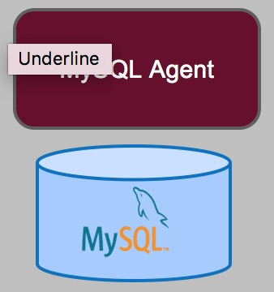
MySQL Operator Demo
Wordpress deployment
Mysql cluster
statefulset
OCI Object storage
mysql-router
mysql-0
backups
mysql-1
Each agent
mysql-router
MySQL Operator Deployment
mysql-2
MySQL Operator
Notes:
11.5 min-17.5min 16:07:30

Slide 37
Presslabs MySQL Operator
https://github.com/presslabs/mysql-operator
Uses MySQL Orchestrator to replication topology management
Uses asynchronous replication
Makes use of the Percona utility user
Uses Percona XtraDB 5.7
Backup/Restore made simple with Backup, BackupSchedule custom resources using XtraBackup
Notes:
9.5-10 min 16:00
The MySQL Operator is opinionated about the way in which clusters are configured. We build upon InnoDB cluster and Group Replication to provide a complete high availability solution for MySQL running on Kubernetes.
The MySQL Operator is a Kubernetes controller that can be installed into an existing Kubernetes cluster.
Once installed, it will enable users to configure and manage MySQL instances using a simple declarative configuration.
The MySQL Operator lets you deploy a highly available clustered MySQL instance into Kubernetes with a single command.
Tasks such as backing up databases and restoring from an existing backup are made extremely easy.
In short, the MySQL Operator abstracts away the hard work of running MySQL inside Kubernetes.
If you want to deploy MySQL inside Kubernetes, we recommend using the MySQL Operator to do most of the heavy lifting for you.
Can run sidecar MySQL router alongside k8s application as a best practice

Slide 38
Containers
Operator
Operator container
Orchestrator container
Init: (both presslabs/mysql-operator-sidecar)
init-mysql
clone-mysql
App:
Percona Container
Side-cars:
side-car (presslabs/mysql-operator-sidecar)
pt-heartbeat (presslabs/mysql-operator-sidecar)
metrics-exporter (prom/mysqld-exporter)
Notes:
Internally, a node consists of several components.
Beside Percona Server for MySQL which is doing the actual heavy lifting of serving your queries, there are a few sidecars:
MySQL Operator initializer - is responsible for seeding the node, from a backup source or from some other peer node
pt-heartbeat - is used for monitoring replication lag
pt-kill - is used for enforcing resource limit policies
Prometheus Exporter - for exposing internal metrics into Prometheus format
MySQL Operator sidecar - takes care of setting up system accounts and also providing seed data for other nodes in the cluster

Slide 39
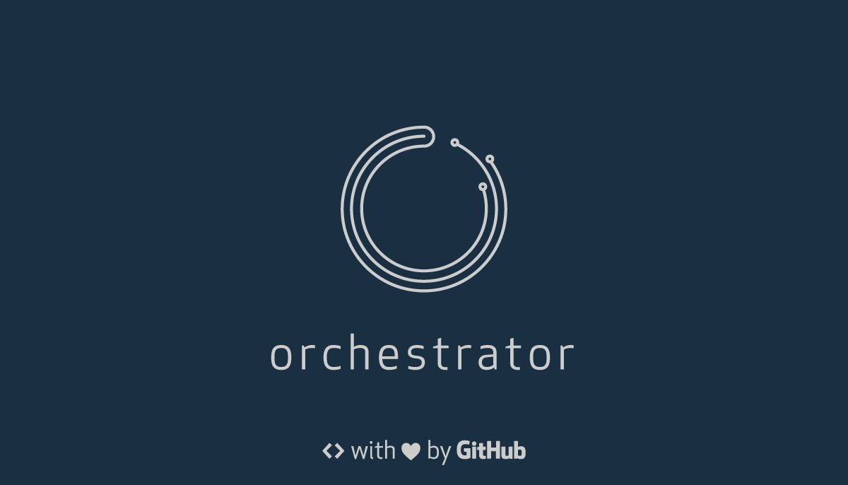

Presslabs MySQL Operator
statefulset
pod
init-mysql
clone-mysql
side-car
Object storage
Kubernetes API
Pt-heartbeat
Operator
CRD
MySQLCluster MySQLBackup
MySQLScheduledBackup
Prometheus exporter
Notes:
sidecar is used for :
backups, clone - those uses rclone utility program to sync backups across storage providers. The sidecar container exposes, over HTTP, an endpoint where another container can connect to request a backup, we chose HTTP because is easier to implement security like authentification(basic auth, which is implemented) and in the future encryption. Behind every request for a backup runs Percona extrabackup. and the output is compressed and streamed over HTTP as mentioned earlier.
Also, the sidecar container runs some queries for MySQL to configure the needed users, like Orchestrator user, replication user, metrics user, configure the master for the replica (CHANGE MASTER TO....), is in charge of making node read-only or writable after it's configured(this is the last action done, in the beginning, the node it's always super read-only and only at the end is made writable or only read-only).
We don't have any examples with other blocks storage, out of using it with the standard cloud-specific storage system.

Slide 40
Presslabs MySQL Operator Demo
This demo will show the following:
A 3 Node cluster created by the MySQL Operator
Show each component such as MySQL orchestrator, the MySQL Operator container, and each pod node with the MySQL and side-car containers
Promotion of one of the slaves to master
The shutdown of the master, observing the cluster repairing itself
https://youtu.be/rlG51bZ6wk
Notes:
Internally, a node consists of several components.
Beside Percona Server for MySQL which is doing the actual heavy lifting of serving your queries, there are a few sidecars:
MySQL Operator initializer - is responsible for seeding the node, from a backup source or from some other peer node
pt-heartbeat - is used for monitoring replication lag
pt-kill - is used for enforcing resource limit policies
Prometheus Exporter - for exposing internal metrics into Prometheus format
MySQL Operator sidecar - takes care of setting up system accounts and also providing seed data for other nodes in the cluster

Slide 41



: sharding on a silver platter (http://vitess.io)
Database solution for deploying, scaling and managing large clusters of MySQL instances
YouTube database store since 2011
Looks like MySQL database in usage, but is sharded underneath
Cloud ready (The cloud is coming!)
Helps you scale with transparent dynamic sharding and ability to continue sharding out (or in)
Cluster management – tools for backups, shards, and schema
MySQL client protocol, gRPC
Connection pooling
Protects MySQL with query - de-duping, re-writing, sanitization, black-listing, adding LIMIT on unbound queries, etc
Monitoring tools - built into all Vitess binaries.
If you want to migrate your MySQL application to the cloud, Vitess is an excellent vehicle to use!
Notes:
17.5-19 min 16:09 Slack, Hubspot, Axon, Square, Youtube, etc
Vitess is cloud-ready
Originally “Voltron”
Vitess helps you with your sharding and helps you scale Vitess has a gRPC-based protocol for lightweight connections vs. libmysql/mysql connections
Connection-pooling uses Go’s concurrency support to map lightweight connections to a small pool of mysql connections
Has its own SQL parser with configurable set of rules to rewrite queries GTID - is used for query rewriting
Variety of support of sharding schemes. Can migrate tables into different databases, scale up/down number of shards. Handles master failover Handles backups Topology store using etcd (or zookeeper) stores information about the sharding scheme and the replication graph. Use of vtctl cli or vtctld web ui NewSQL: class of modern relational database management systems that seek to provide the same scalable performance of NoSQLsystems for online transaction processing (OLTP) read-write workloads while still maintaining the ACID (Atomicity, Consistency, Isolation, Durability) guarantees of a traditional database system
Applications targeted:
are short-lived (i.e., no user stalls)
touch a small subset of data using index lookups (i.e., no full table scans or large distributed joins)
are repetitive (i.e. executing the same queries with different inputs)
Transparent sharding(!!!)

Slide 42
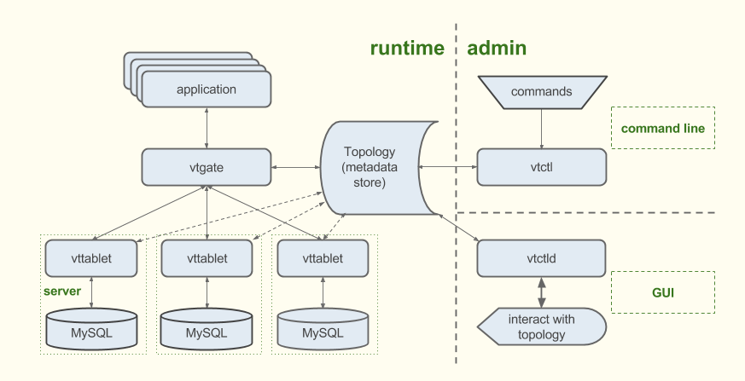
orchestrator
Notes:
19-20 min 16:10
VTgate – lightweight proxy used for routing queries to appropriate VTtablet
Topology Server – service/lens to etcd store of coordination data, keyspace graph used to determine which shards to use, used for initial discovery of what is there
Vttablet – shard proxy server provides connection pooling using Go’s concurrency support to a small pool of msyql conns, query sanitization, blacklisting, deduping, where clause on unbounded queries
VTctld – provides web UI and performs all the cluster management work
Orchestrator – watches mysqls, communicates VTctld which does reparenting of vttablets vtctl – command line for interacting with Vitess through topology server Topology Server
Service/lens to etcd, Stores coordination data - used for initial discovery of what is there
contains keyspace graph used to determine which shards to use for a given keyspace, cell, and tablet type
Vtgate
A lightweight proxy the client/application talks to.
Using the sharding scheme, availability of VTtablets and underlying mysqlds, routes each client query to vttablet(s)
A service distributes connections to a pool of vtgate pods
Will break up the query into smaller parts if necessary for being sent to different vtablets - routing - interacting with topology, select count(*) will consolidate from other vttablets
Vtablet
Shard proxy server in front of the mysql database.
connection pooling, maximizes throughput
Query deduping
Will rewrite queries based on various rules
adding a limit clause unbounded
rewriting certain writes/updates
certain statement-based replication statements
protects mysql from harmful queries, most protection code here
initiates tasks that vtctl initiates
- provides streaming services used for filtered replication and data exports
Vtgate otherwise uses direct connection from vttablet relying on health check from vttablet
When new vttablet becomes master it will tell all vtgates that it is the master
Vtctld server
Provides a web UI or through CLI vtctl to inspect and manage the state of the Vitess cluster
Performs all of the cluster management work
Orchestrator
configured to watch all the mysqls (talks to vtctld, vtctld does the talking to vttablets and running commands for reparent)
Orchestrator does reparent through vtctld
“I have done the reparent of the mysqld, please inform the vttablet of this”
Vttablet will inform all of the vtgates of this reparent
If it does do a reparent, it will inform the vttablet that is running the mysql that it is the new master and then vttablet communicates
Vtworker
transfer data from source shard to destination shard
hosts long-running processes
Has a plugin architecture for things like
resharding differ
Vertical split differ
Lets you add other validation procedures
Vtworkers are brought up when resharding
Vtcombo - single binary containing all vitess components
Vtexplain - CLI used to explore how vitess will handle queries
Monitoring:
Graph works
Collectd plugin
Prometheus plugin
Graphite ...

Slide 43
Sharding
A shard consists of a single master that handles writes, one or more slaves that handle reads
Horizontal - split or merge shards in a sharded keyspace
Vertical - moving tables from an unsharded keyspace to a different keyspace
Re-sharding
split, merge, add new cells and replicas
Filtered replication using GTID key ingredient ensures source tablet data is transferred to proper destination VTtablet
Vschema - Vitess Schema - ties together all databases managed by Vitess and helps to decide where queries should go
Vindex - cross-shard index provides a way to map a column value to a keyspace ID
Notes:
20-21 min 16:11 Keyspace – logical database
Keyspace ID – value used to decide what shard a given record belongs to
Vschema - Vitess Schema -
Simply put, it contains the information needed to make Vitess look like a single database server.
all the parallels of a regular schema, but helps to decide where queries should go
In contrast to a traditional database schema that contains metadata about tables, a VSchema contains metadata about how tables are organized across keyspaces and shards.
Contains information about the sharding key for a sharded table
When the application issues a query with a WHERE clause that references the key, the VSchema information will be used to route the query to the appropriate shard.
Lookup keyspaces - unsharded, used vindex lookup tables, sequences, your own unsharded tables
Lookup vindex - tells you they keyspace id, keyspace id directs you to a given shard. Can be lookup keyspace or sharded Not hard-coded, lets you control how a column maps to a keyspace ID
Primary - unique. Every sharded table must have one defined
Secondary - offers optimizations (vtgate) for WHERE clauses not using Primary Vindex
Unique - one keyspace ID and NonUnique - multiple keyspace IDs
Functional - pre-established through function, primary Vindex usually this
Lookup - allow you to create association between a value and keyspace ID
Shared Vindex - multiple tables, like foreign key
Sequences
Vtctlclient (GRPC) interacts with vtctld for managing shards
Apply Vschema
List tablets
Create schema, query data,
Create and manage backups
Check data integrity
Switch to newly-created shards
Query what exists on each shard
Remove shards

Slide 44
Schema and Vschema
// vschema - user keyspace { "sharded": true, "vindexes": { "hash": { "type": "hash" }, "tables": { "user": { "column_vindexes": [ { "column": "user_id", "name": "hash" # NOTE: vindex name } ] } } }
# schema - user keyspace
create table user(
user_id bigint,
name varchar(128),
primary key(user_id)
);
Notes:
21-22 min 16:12
Vschema - all the parallels of a regular schema, but helps to decide where queries should go VSchema stands for Vitess Schema. In contrast to a traditional database schema that contains metadata about tables, a VSchema contains metadata about how tables are organized across keyspaces and shards. Simply put, it contains the information needed to make Vitess look like a single database server.
For example, the VSchema will contain the information about the sharding key for a sharded table.
When the application issues a query with a WHERE clause that references the key, the VSchema information will be used to route the query to the appropriate shard.
Lookup keyspaces - unsharded, used vindex lookup tables, sequences, your own unsharded tables
Lookup vindex - tells you they keyspace id, keyspace id directs you to a given shard. Can be lookup keyspace or sharded

Slide 45
Reparenting
Reparenting
Changing shard’s master tablet to another host
Changing slave tablet to have a different master
GTID
GTID is used to initialize replication
GTID replication stream is used in parenting
Types of reparenting
PlannedReparentShard - healthy master tablet to new master
EmergencyReparentShard - forces reparent to a new master when master unavailable. Data connect be retrieved from current master
Re-sharding
split, merge, add new cells and replicas
Filtered replication key ingredient ensures source tablet data is transferred to proper destination VTtablet
Notes:
22-23 min 16:13
Planned -
Put into read-only
Shut down query service until new master configured
Retrieve current master rep pos
Instruct master elect tablet to wait for rep data then start as new master once data xferred
Ensures rep is functioning using
test table update the global Shardobject's MasterAlias record.
In parallel each slave and new master, set new master, wait for test entry to replicate
Start replication on old master so it catches up to new master
Emergency
Determine current pos on all slave tablets confirm master elect tablet most advanced replicated pos
Promote master elect to new master
Some ensure process as planned

Slide 46
backups
Storage (NFS, S3, GCS, Ceph)
vttablet
Object storage
mysql
Mysqlctl
backup
Backup
Plugins for NFS, GCS, S3, Ceph
VTtablet must have access to where storage, flags to provided to vtctl
Replica MySQL instance stopped, data copied, instanced started
vtctl backup <tablet-alias>
Restore
For restore, VTtablet started with arguments specifying whether to restore from a backup, the storage implementation and backup storage root (path)
Commands
vtctl backup <tablet-alias>
vtctl ListBackups <keyspace/shard>
vtctl RemoveBackup <keyspace/shard>
Notes:
23-23.5 min 16:13:30
When backing up a vttablet,
Switches type to BACKUP, tablet then not used by vtgate for any query
Stops replication
Shuts down mysqld
Copies files to backup location
Restarts mysql
Restarts replication
Switch type back to original type
Backup frequency through cron job

Slide 47
Vitess Operator
VitessCluster – top level specification
VitessCell – Failure domain/AZ
EtcdCluster
Deployment(s) orchestrator, vtctld, vtgate
VitessKeyspace – comprised of multiple shards
VitessShard – multiple vttablets, creates multiple StatefulSets of pods and PersistentVolumeClaims
kubectl get vitessclusters
Notes:
23-23.5 min 16:13:30
When backing up a vttablet,
Switches type to BACKUP, tablet then not used by vtgate for any query
Stops replication
Shuts down mysqld
Copies files to backup location
Restarts mysql
Restarts replication
Switch type back to original type
Backup frequency through cron job

Slide 48
Vitess StatefulSet Demo
https://youtu.be/9in5HenJ9xY
Create two shards
Load database schema and vschema
Scale one shard from 2 replicas to 3
Delete StatefulSet, delete master pod, reparent
Anthony Yeh, https://github.com/enisoc/vitess.git, statefulset-demo branch
Notes:
23.5-29.5 min 16:19:30
Statefulsets: 1. Restore no longer required as statefulsets guarantee storage stickyness to pod
2. Scale easily changing statefulset vs. create a new pod manually
3. Identities are important to vitess, statefulsets ensure this as we saw in the demo

Slide 49
Questions Preguntas Fragen सवाल... Patg at Patg dot net http://patg.net

Slide 50
Thank you!
Special thanks to:
Ali Mukadam
Platform Team Oracle Dyn
Anthony Yeh
Sugu Sougoumarane
Adrew Pryde
Owain Lewis
Kubernetes Community!

Slide 51
Extra slides - resources

Slide 52

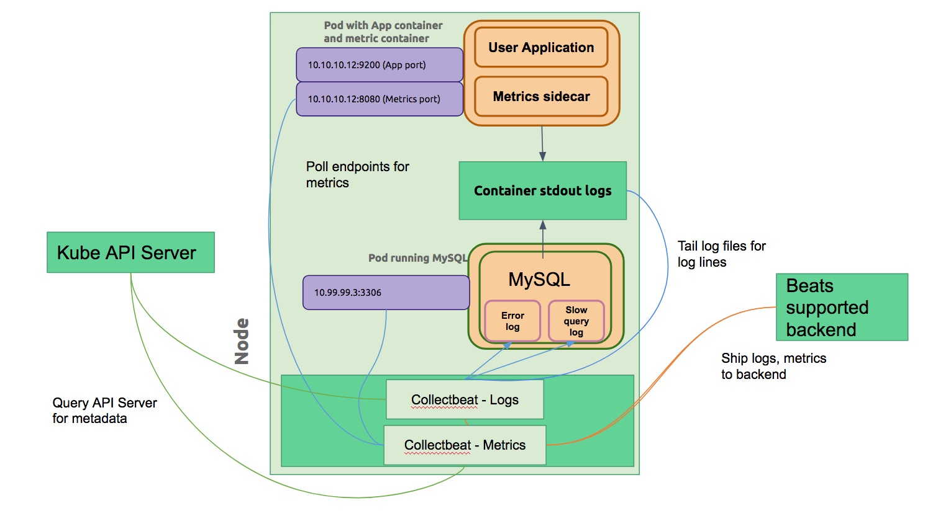
Collectbeats
Open Source effort within Ebay
Inspired by Metricbeat module “drop in” concept.
Find all pods exposing metrics and start polling
Ability to
Collect metrics from any pod that exposes them
Collect logs from STDOUT or logs on container
Append pod metadata to logs and metrics
Allow pods to push metrics through Graphite protocol and parse them uniquely
Stitch stack-traces for application logs
http://bit.ly/2zT4VNZ
Notes:
Simple as writing to stdout
For metrics export and endpoint and write an annotation - io.collectbeat.metrics/endpoints: “:9090”, io.collectbeat.metrics/type: “prometheus”
As long as it has a prometheus endpoint
This makes it discoverable (by adding annotation) then we can append
Makes it possible to to map metric to container and discoverable to the user
One thing in common is using k8s api for discovery Ebay contributed Graphite server as Metricbeat module
HTTP server for sending json payload of metrics to Metricbeat to be shipped to backend of choice
With the combined effort of eBay and the Elastic, Beats will have native Kubernetes support in 6.0. implemented “Graphite server” as a Metricbeat module and contributed it back to Beats
Filebeat - process log files
Metricbeat - modules collect metrics from pods/apps given port and command to run
Ebay built functionality to discover based on presence of 3 mandatory annotations: type of metric, endpoints/ports to look at, namespace to write metrics into

Slide 53
Other MySQL installation examples
helm install --name kubeconf stable/percona
https://www.youtube.com/watch?v=kZOk0w6YKMA
Simple replication with a stateful set https://kubernetes.io/docs/tasks/run-application/run-replicated-stateful-application/
https://www.youtube.com/watch?v=M7EWFL83Vdc
Galera StatefulSet by SeveralNines https://severalnines.com/blog/mysql-docker-running-galera-cluster-kubernetes
https://youtu.be/3vn7Jd9z4kc

